Slide 1


( Job Portal) JPL CSD – 3184 MOBILE DEVELOPMENT
Prepared by:
Lizza Parmar( C0726331)
Parulpreet Khurmi (C0722150)

Slide 2
Contents
Introduction
Problem Specification
Users of the System
Results
Summary
Future Enhancement
Responsibilities

Slide 3
Introduction
AIM AND OBJECTIVE
This Project Provide a common platform for both job seekers and Recruiters. It connects employer and job seekers where employers are the source of the resources and the job seeker can find and apply for their targeted job.
This application aims to provide the candidates ability to register to this application and search for jobs, manage their accounts. On the other hand recruiters that are willing to publish the jobs can register to the online job portal and get their own account created and can post jobs to portal‘s database. Also, registered recruiters can add or remove jobs and these jobs can be seen by various candidates and they can contact them through e-mail. The main aim of this project is to make a good application that can make the job search option easy and accessible to everyone who are interested.

Slide 4
Problem Specification
Before creating this application, all jobs seekers used to send their resumes or information through postal mails or by person to person contacts with each other. This took long time to send their requirements to employers and also employers faced the problems to collect all the information from clients and consultants.
So, the above mentioned problems are solved by our Online Job Portal.
Users of the System
The main stakeholders of this system are:
Employee/Employeer
This module contains details about Jobs.
They can register and create a profile.
Perform edit/delete operation on their profile.
They can search and apply for jobs online.
View application status through e-mail.

Slide 5
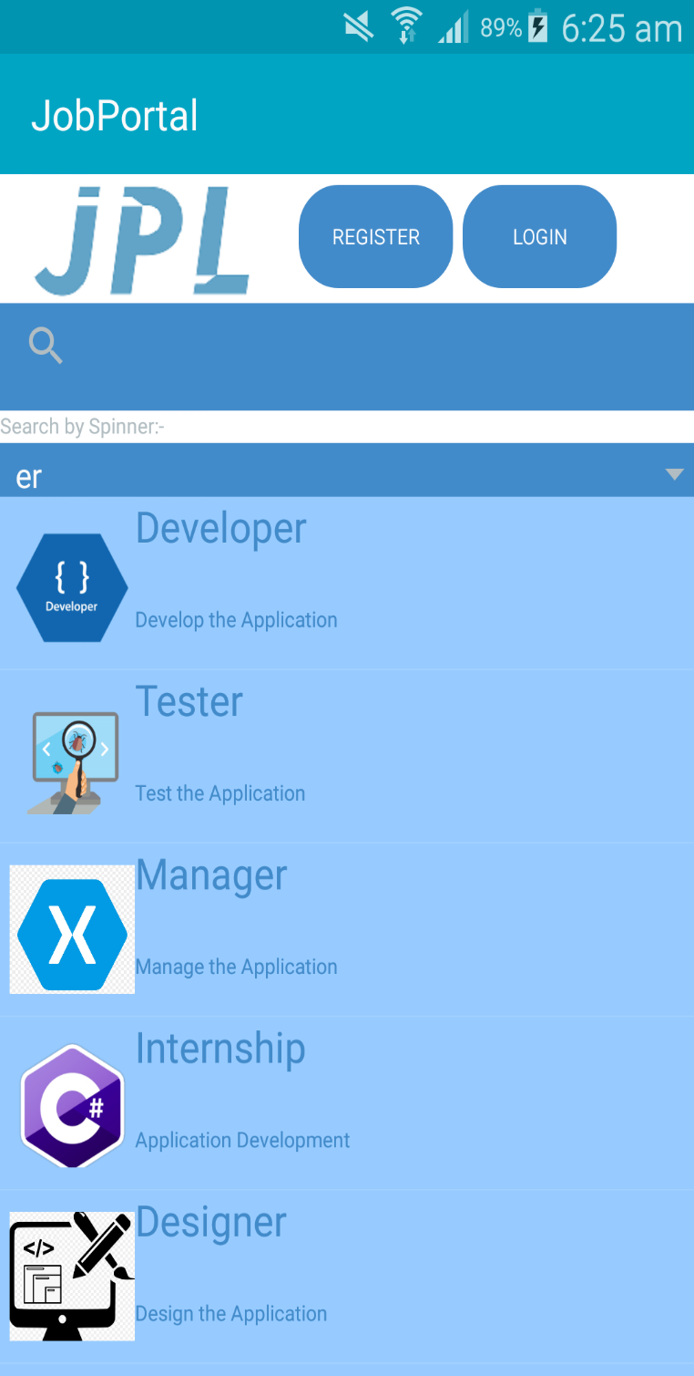
Results
HOME PAGE

Slide 6
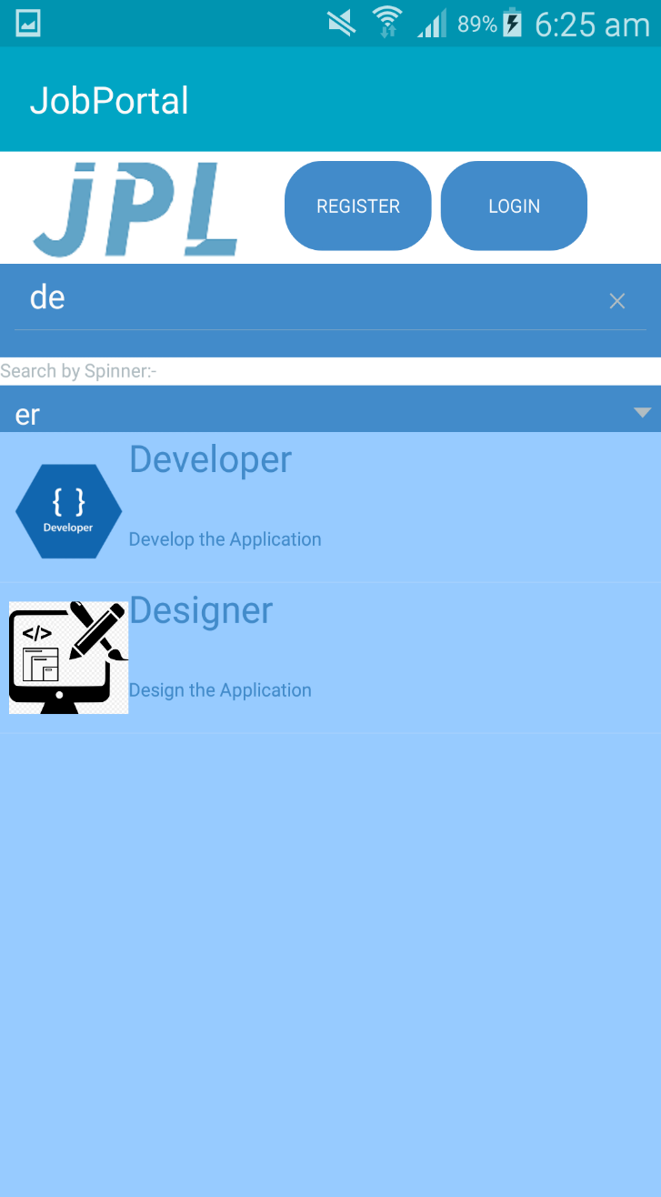
SearchView Functionality:-

Slide 7
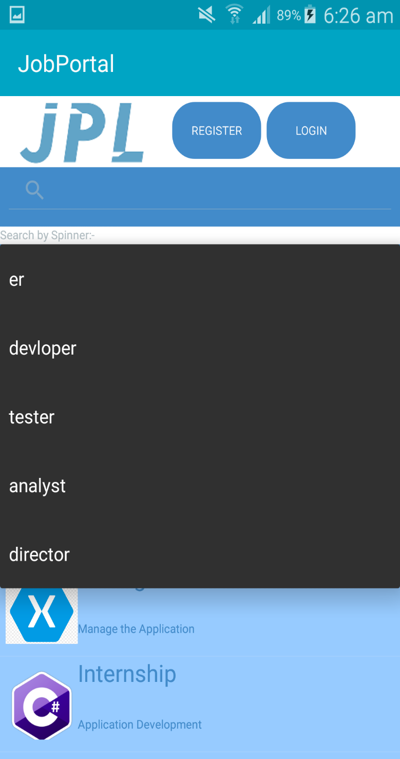
Search By Spinner :-

Slide 8
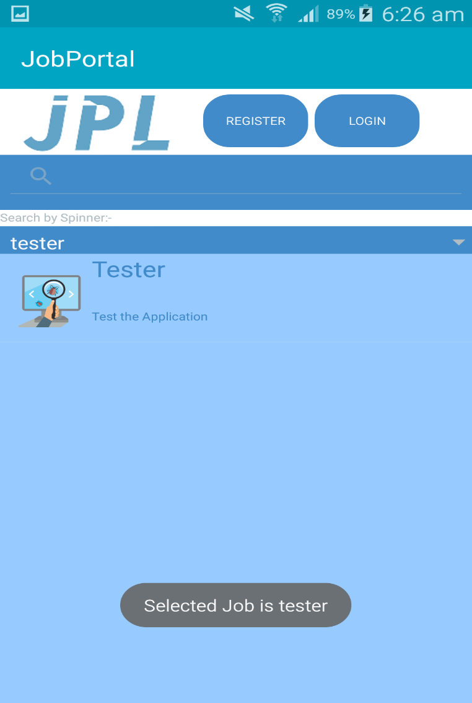
Result of search “tester” by using spinner:-

Slide 9
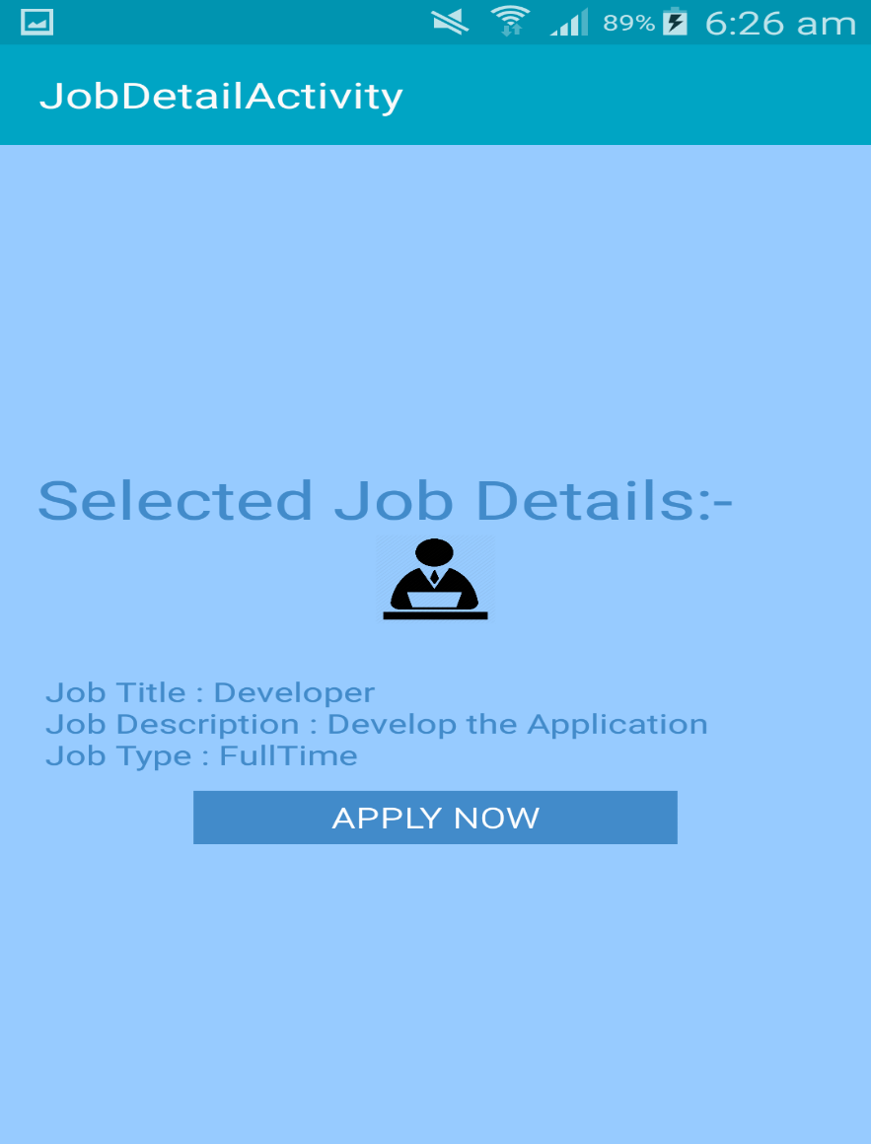
Click on any job will go to detail page:-

Slide 10
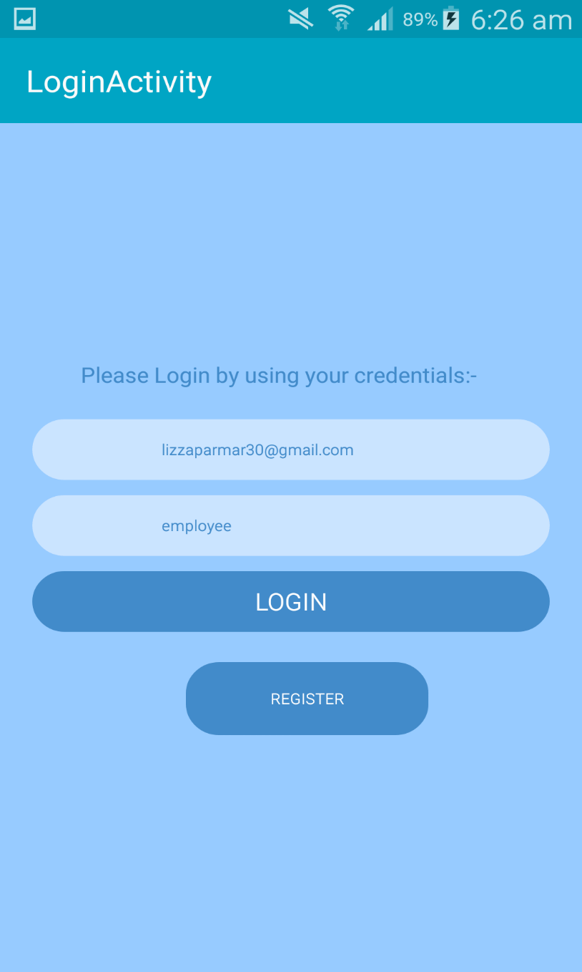
LOGIN

Slide 11
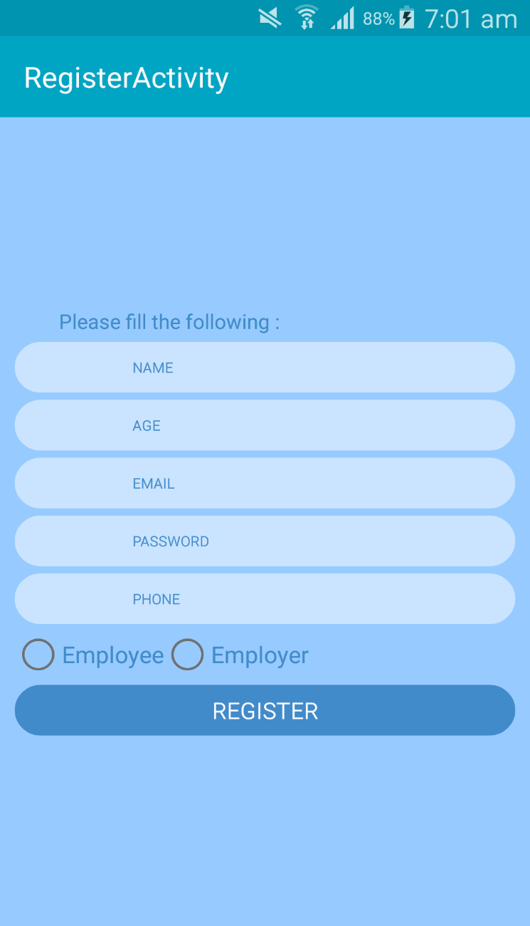
Register Screen:-

Slide 12
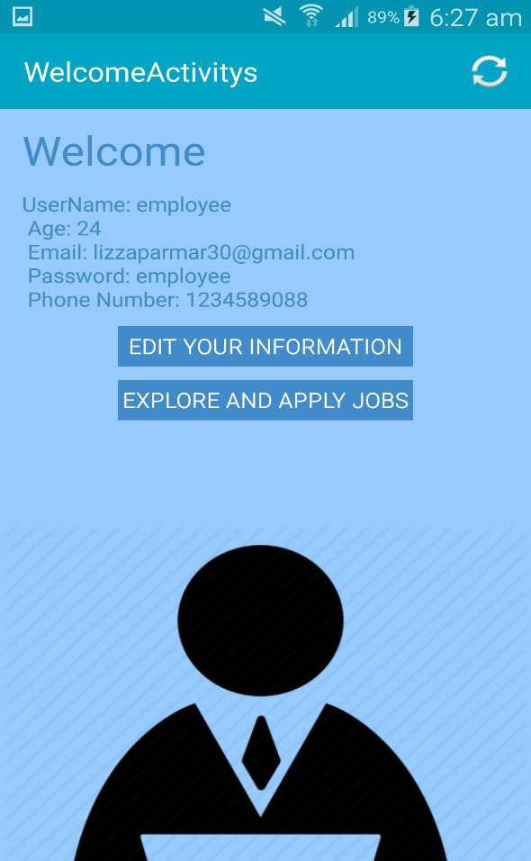

WELCOME SCREEN with ScrollView:-

Slide 13
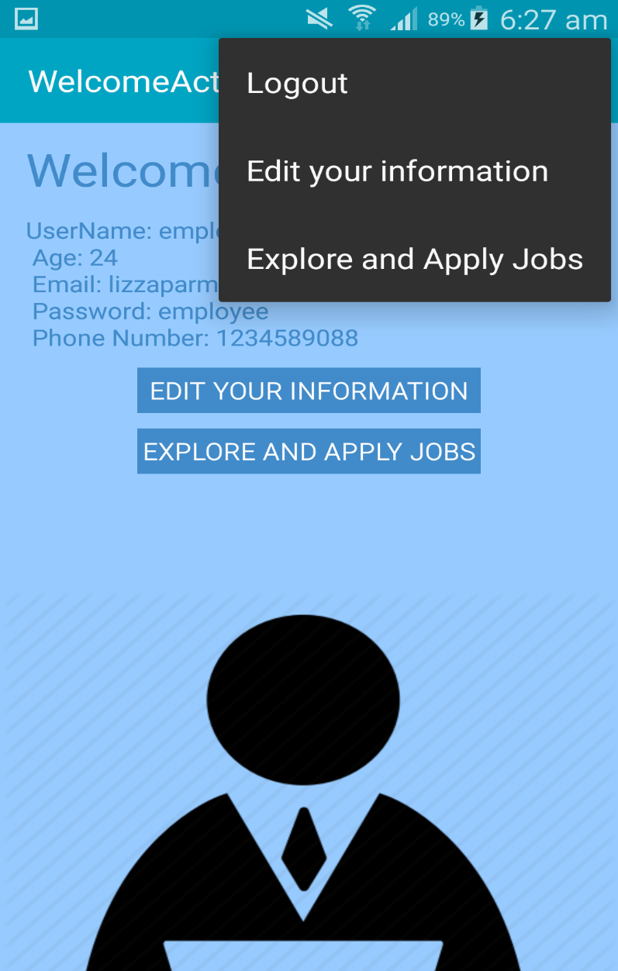
Menu on Welcome Screen:-

Slide 14
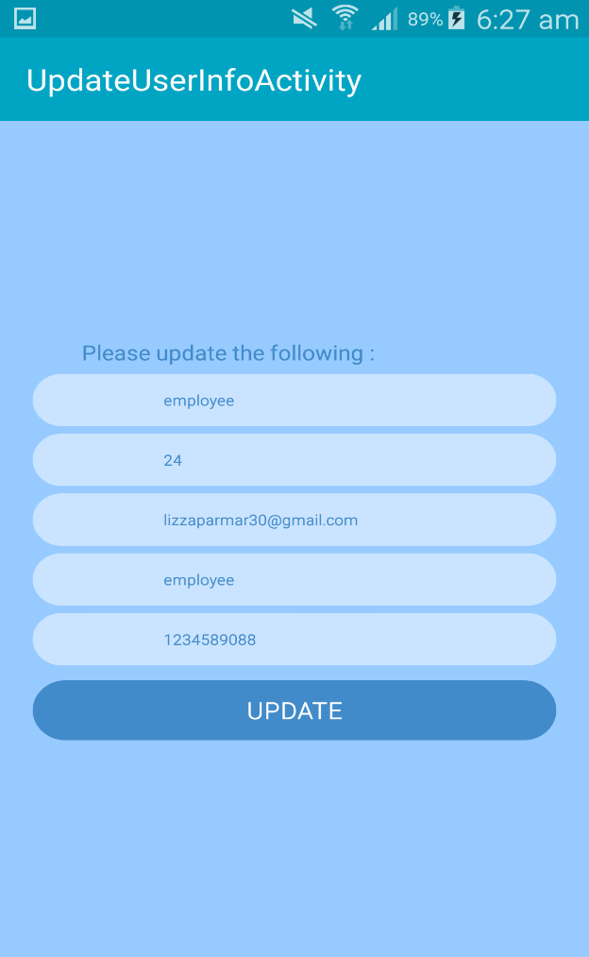
UPDATE THE USER INFO FUNCTIONALITY:-

Slide 15
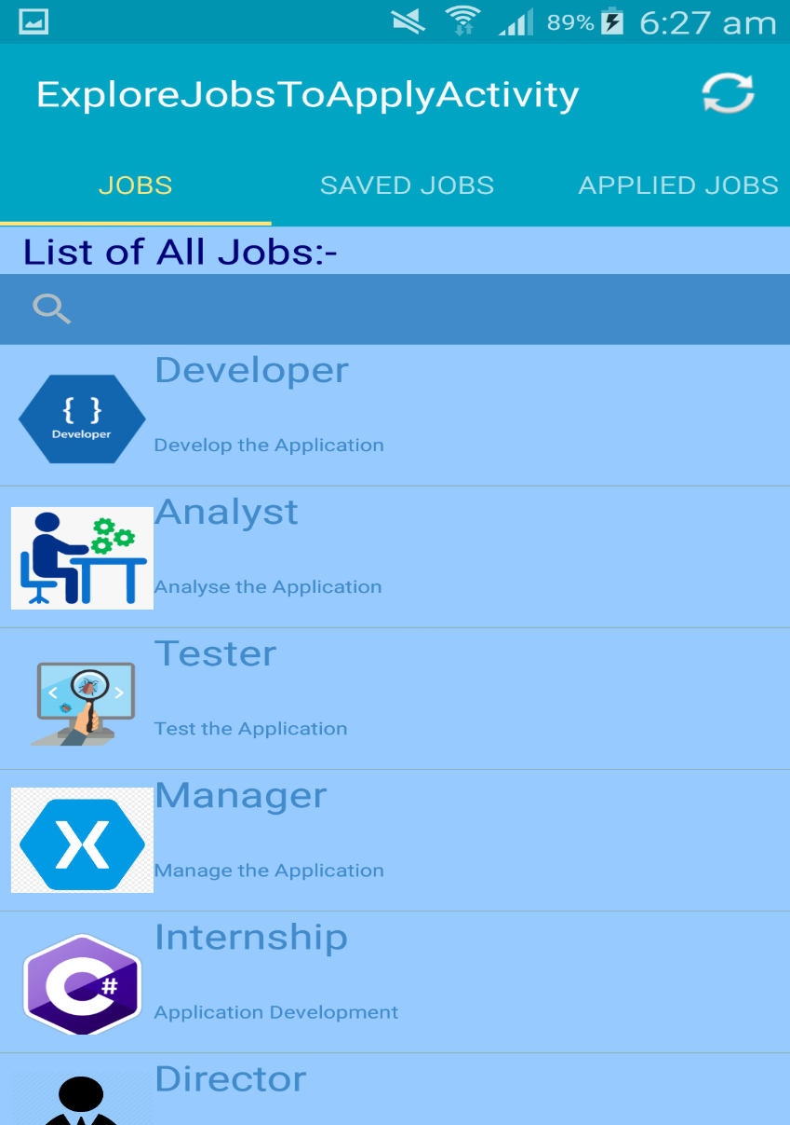
TABS with search with images with menu:-

Slide 16
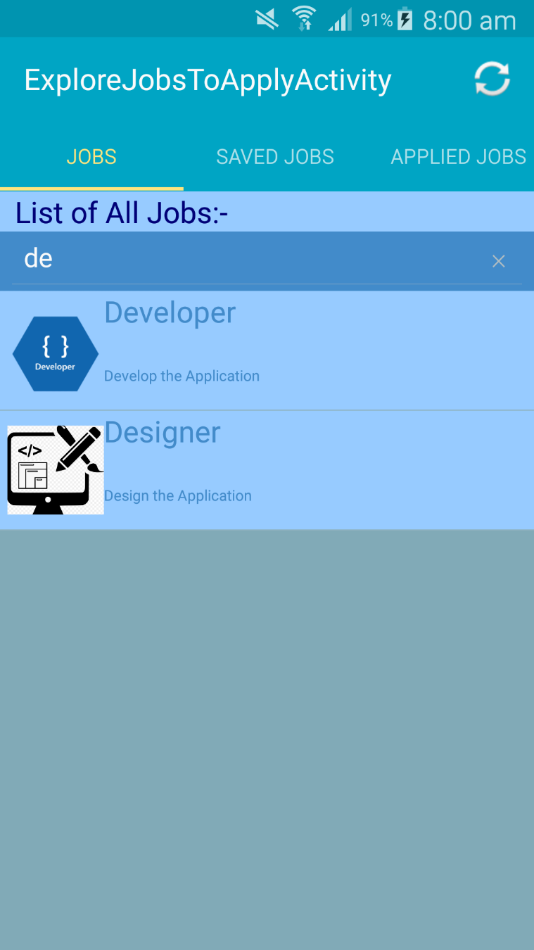
TABS with search

Slide 17
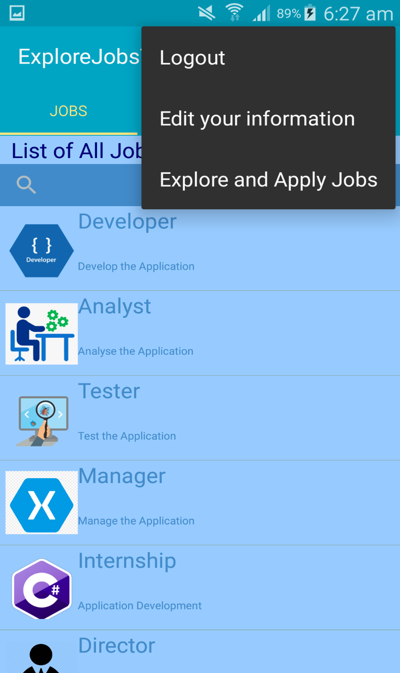
menu

Slide 18
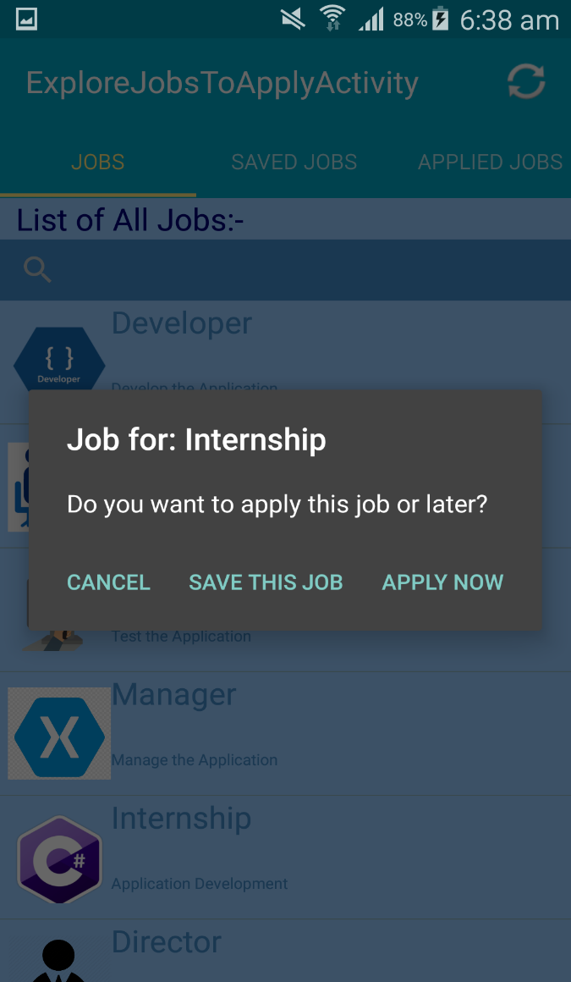
Select any job with show 3 options:-

Slide 19
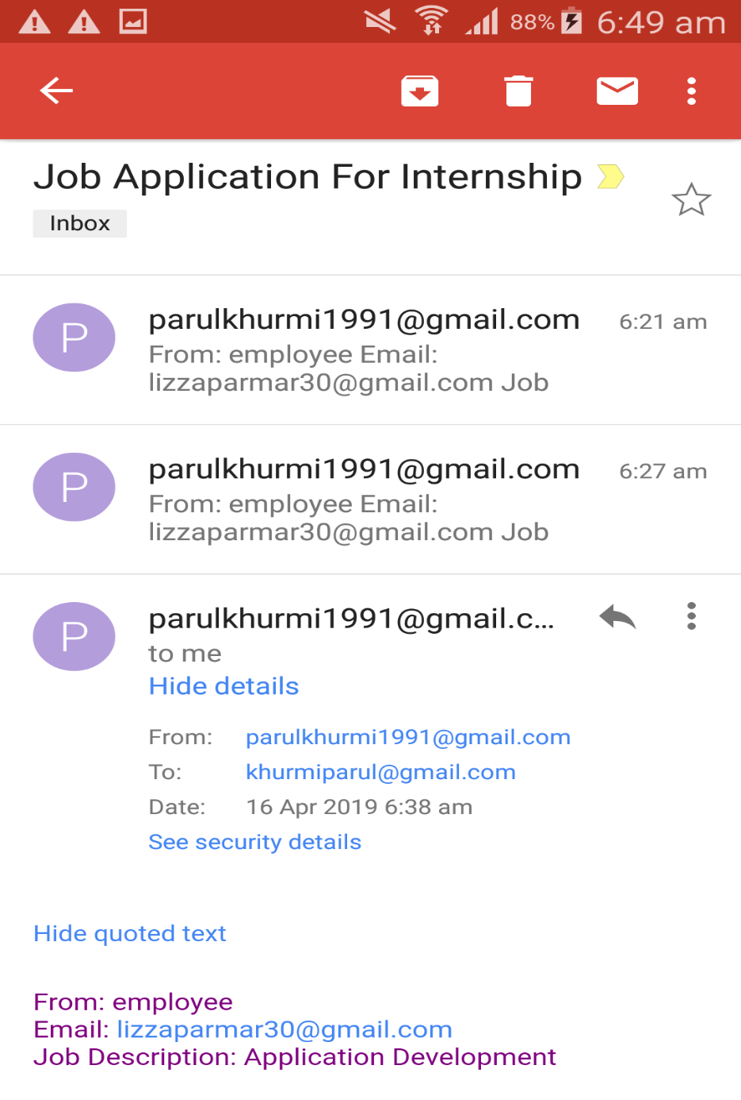

Slide 20
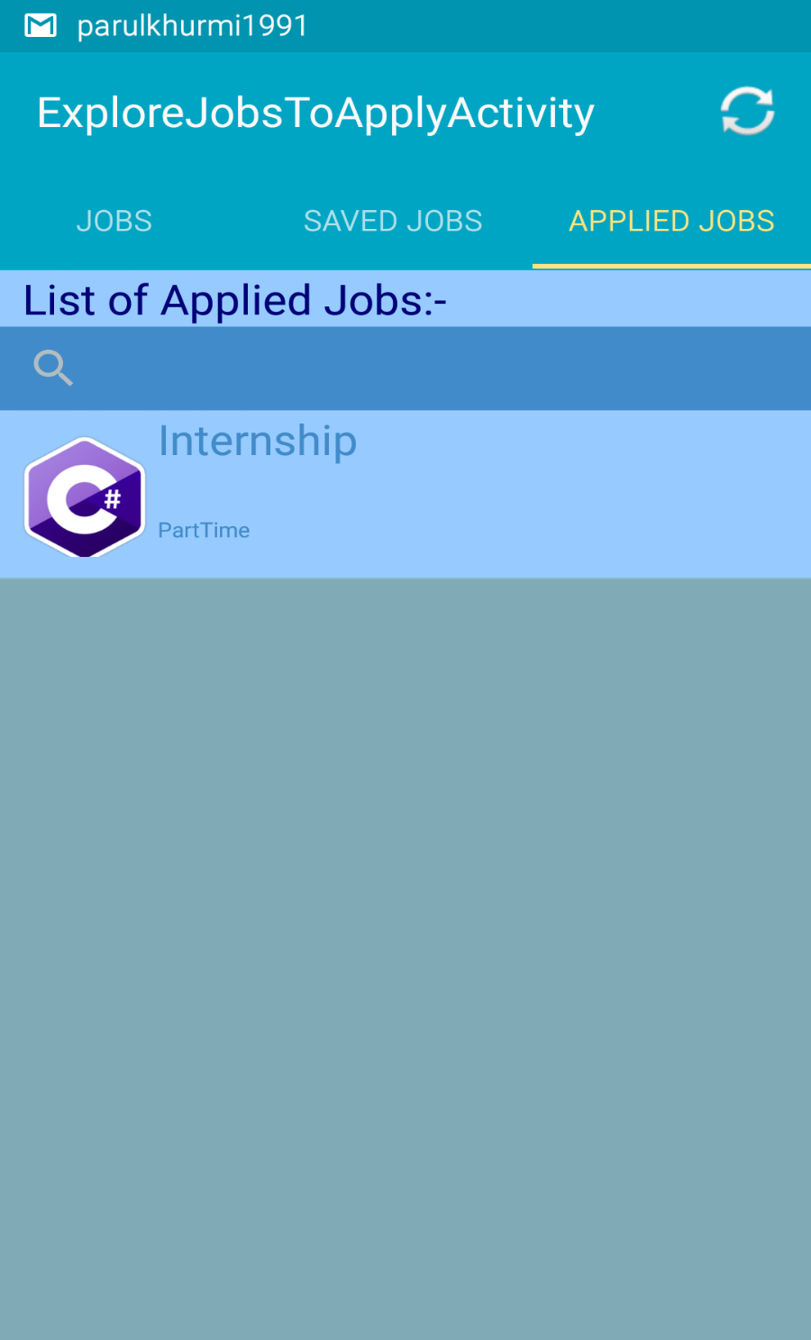

Slide 21
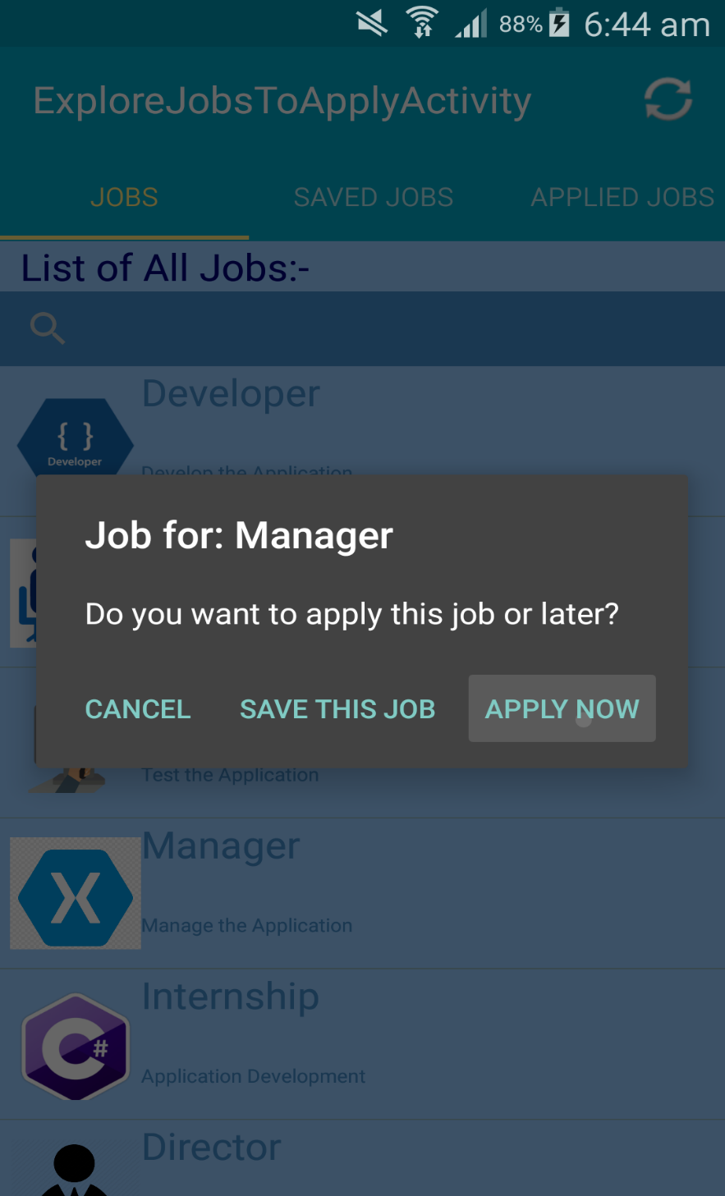

Slide 22
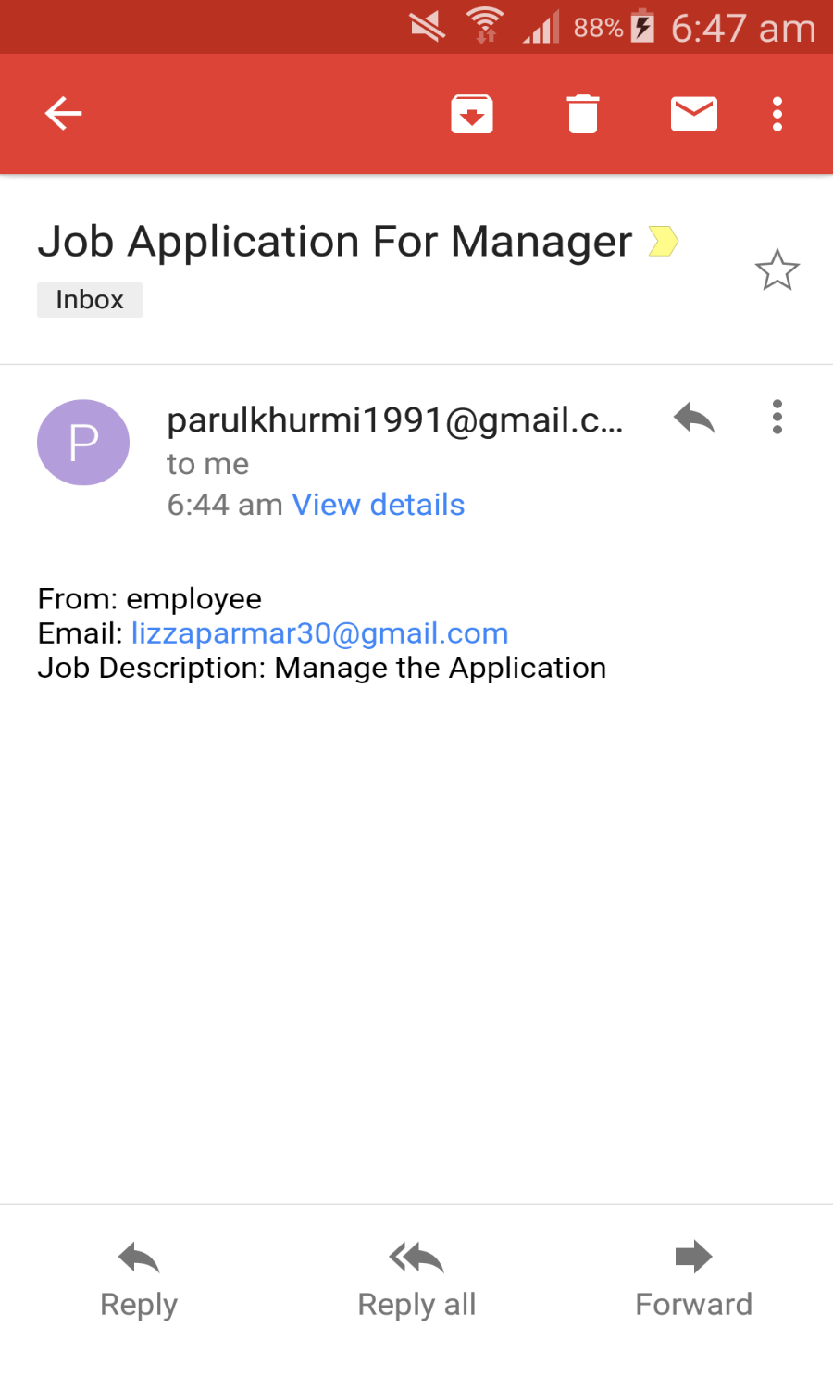

Slide 23
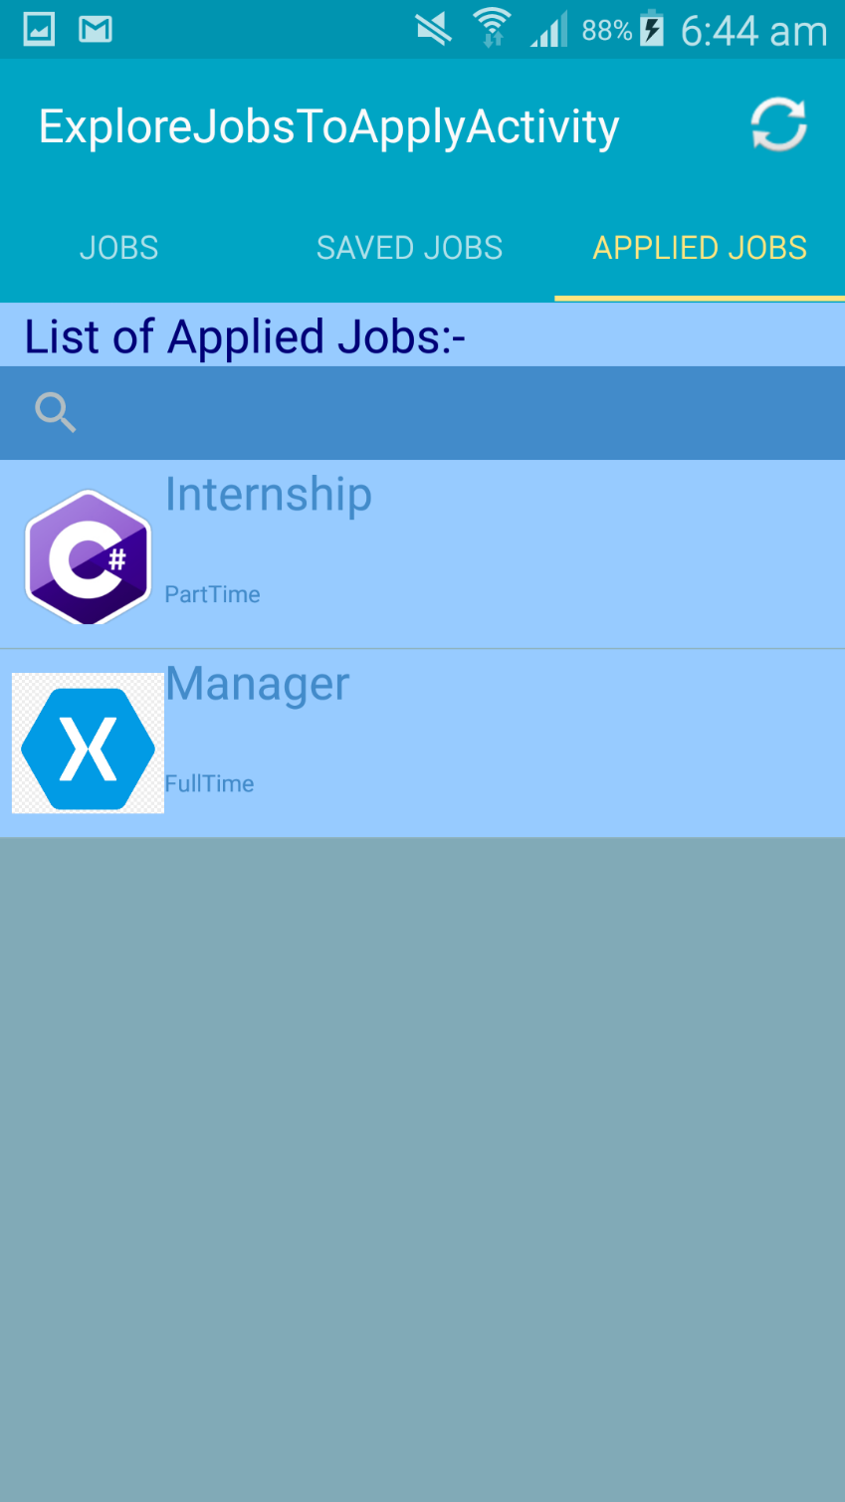

Slide 24
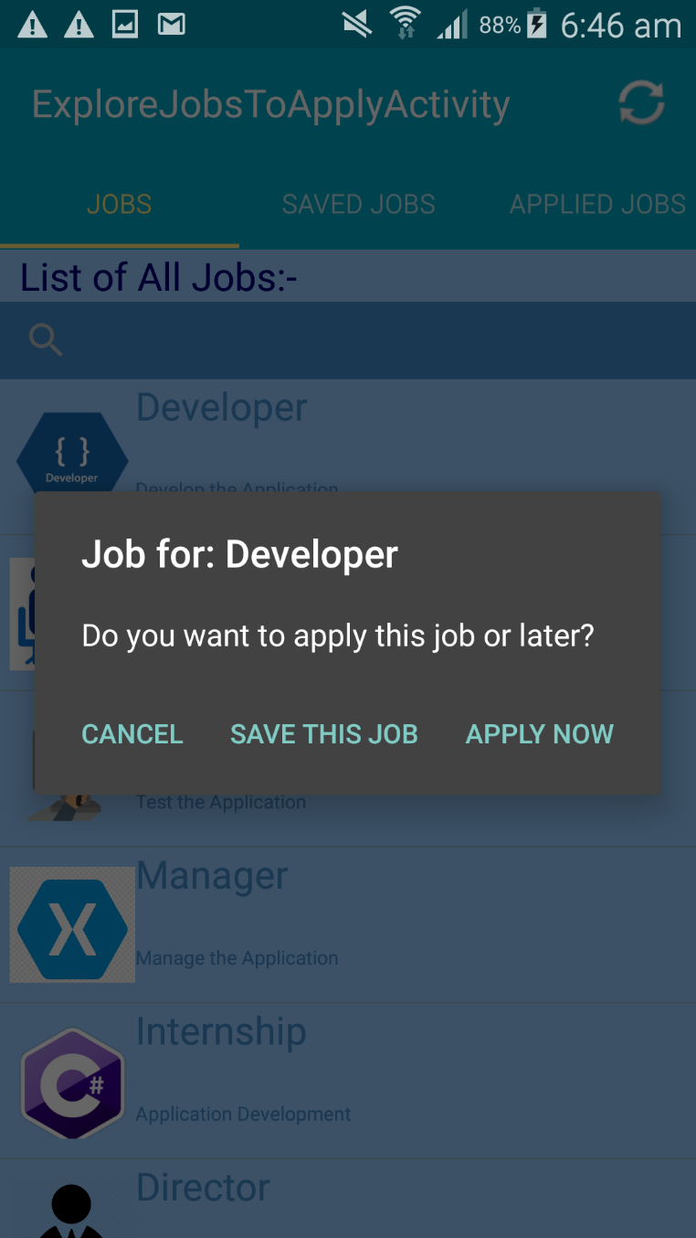
Save the Job:-

Slide 25

Saved Job List:-

Slide 26

After Logout, Login Screen:-

Slide 27
SUMMARY OF RESULTS
To, conclude this project provides various features with the ease to find and apply for various jobs online. Employers and Employee can easily use and manage their work on this application. As this is a well designed and easy-to-use communication system it will certainly give the job portal an edge over the other job portals with outdated and manual communication system .
With automatic features like getting candidates information, company information, getting job vacancies , editing user account etc this application turns out to be a very suitable one.

Slide 28
FUTURE ENHANCEMENT
There is always a room for improvement in any software package, however good and efficient it may be. The important thing is that the site should be flexible enough for further modifications.
Considering this important factor, the application is designed in such a way that the provisions are given for future enhancement. At present this application is limited to searching jobs, applying for any job and e-mail functionality but in future it can be enhanced by many more methods and functionality like Searching alphabetically, getting notification, more friendly user interface and many other ways depending on requirements

Slide 29
RESPONSIBILITES
Lizza Parmar:-
Register(Employee/Employer(role based(option buttons))), Login
Edit Employee Profile details, updated back on welcome screen
List View on home page
Help in database
Parulpreet Khurmi:-
Spinner View, Search View and Menu
job detail page from first page
Tabs functionality by using fragments with database for whole job list, saved job list, and applied job list
Send an email for job application submission to the employer’s email id from database

Slide 30
Thank You…

